Slide 1



ANÁLISIS DE DATOS EN
PACIENTES POST
ACV-ISQUÉMICO, USANDO
TÉCNICAS CLÁSICAS DE
MACHINE LEARNING
Autor
Abraham Marianjel Sepúlveda
Profesora Guía
Carola Figueroa Flores
Profesores Co-Guía
Carlos Escudero Orozco – Andrés Rodríguez Morales

Slide 2
TABLE OF CONTENTS
01
02
03
ANNOUNCEMENTS
IN DEPTH
IN BRIEF
04
05
WELCOME!
EVENTS
Here you could describe the topic of the section
Here you could describe the topic of the section
Here you could describe the topic of the section
Here you could describe the topic of the section
Here you could describe the topic of the section

Slide 3
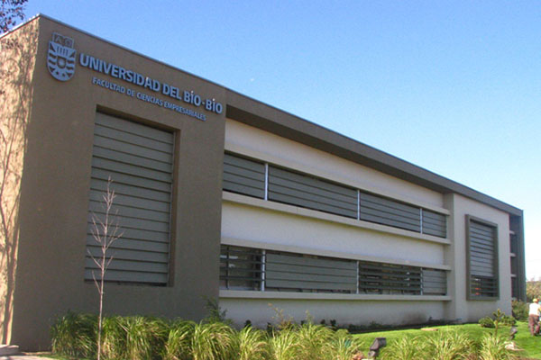
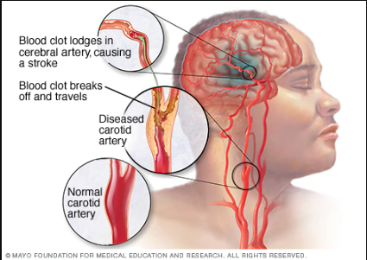
Motivación
Diálogo
Aporte de la investigación al área de salud.
IA
Pretende que las máquinas posean las mismas capacidades que el ser humano.
ACV
Sucede cuando la sangre que está en el cerebro se detiene.

Slide 4
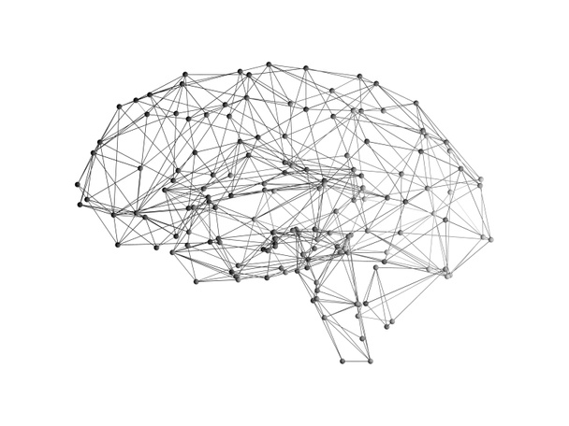
Llamado de atención para los ñublensinos[4]
2018
Descripción del Problema
2019
Mortalidad alta y secuelas[2]
Factores de riesgo para esta enfermedad[3], Aumento de ACV en edades tempranas[1]
2020
2020
Disciplina poco explotada, se arriesgaron con la tuberculosis.[5]

Slide 5
“Es posible determinar la técnica de ML más precisa, con el fin de clasificar según el tipo de secuela a los pacientes que han sufrido ACV Isquémico del Hospital Herminda Martín.”
Hipótesis

Slide 6
Objetivo
01
Estudiar las distintas técnicas de ML que existen en la literatura.
Detectar la mejor técnica de ML para identificar los factores de mal pronóstico en adultos con diagnóstico de ACV Isquémico a través del análisis comparativo de su precisión para pacientes del Hospital Herminda Martín.
02
Determinar qué técnicas de ML se van a comparar.
03
Elegir un mecanismo adecuado, para aplicar un modelo de ML al problema.
04
Implementar las técnicas seleccionadas de ML, para identificar la similitud entre las variables clínicas en los diferentes grupos y las variables que tienen mayor importancia en el pronóstico de los usuarios con diagnóstico ACV isquémico.
05
Realizar una comparación de las distintas técnicas de ML, en base a su precisión.

Slide 7
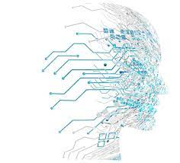
Literatura relacionada
NIHSS
Desafíos Bioéticos en la IA
Escala médica de Neurolgia.
Estudio realizado en Corea del Sur
Logistic Regression
Decision Tree
Algoritmo de Machine Learning.
Algoritmo de Machine Learning.
Naïve Bayes
Random Forest
Algoritmo de Machine Learning.
Algoritmo de Machine Learning.

Slide 8
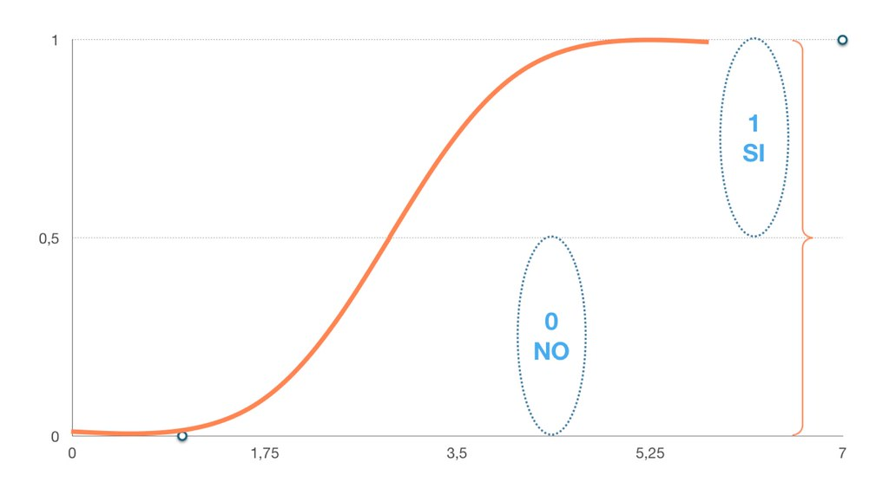
Logistic Regression
Algoritmo de clasificación donde la variable objetivo es de naturaleza dicotómica.
Se utiliza para estimar la probabilidad de una respuesta binaria basada en una o más variables predictoras o independientes.

Slide 9
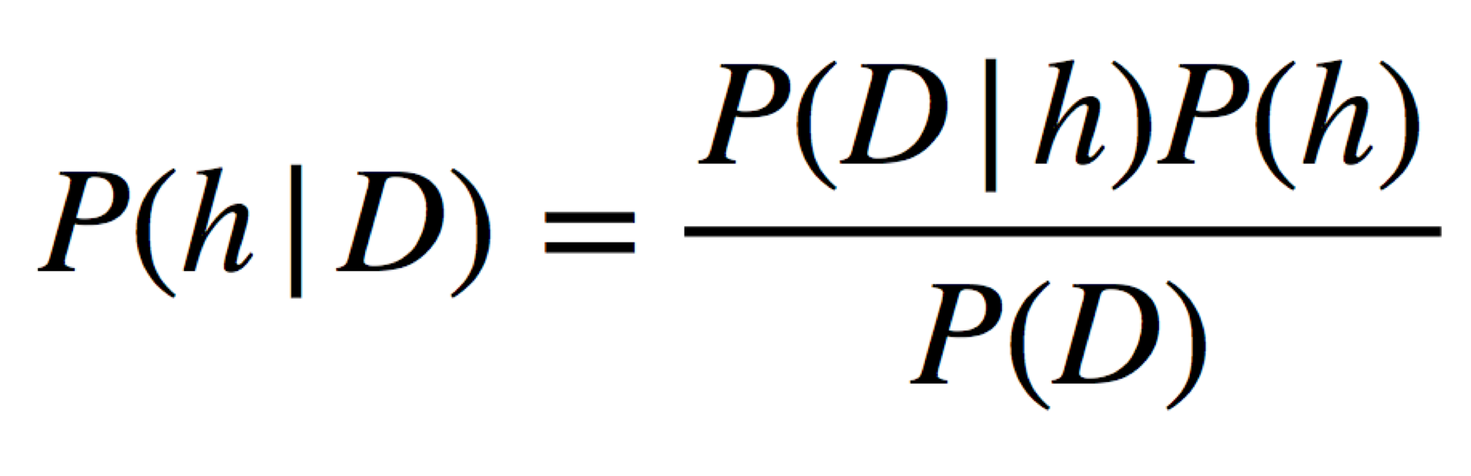
Naïve Bayes
Es uno de los algoritmos más simples y poderosos para la clasificación basado en el Teorema de Bayes con una suposición de independencia entre los predictores. Naïve Bayes es fácil de construir y particularmente útil para conjuntos de datos muy grandes.

Slide 10
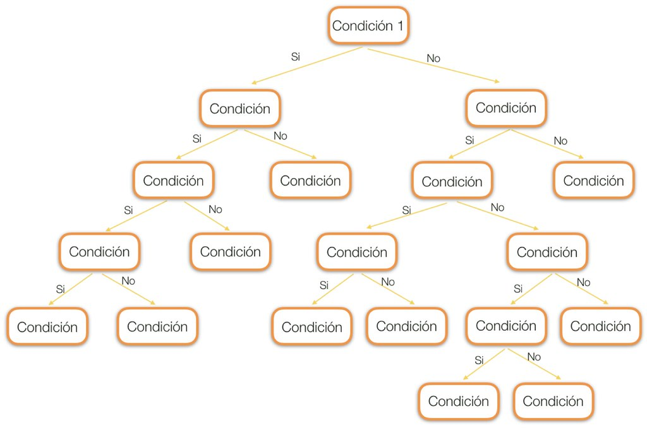
Decision Tree
Tiene una estructura similar a un diagrama de flujo donde un nodo interno representa una característica o atributo. Es muy popular y fácil de ver para el ojo humano.

Slide 11
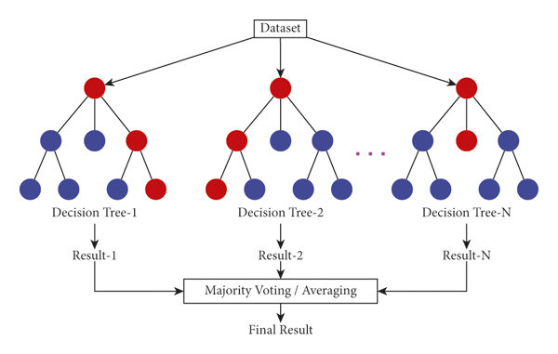
Random Forest
Un bosque está compuesto de árboles. Se dice que cuantos más árboles tenga, más robusto será el bosque. Los Bosques Aleatorios crea árboles de decisión a partir de muestras de datos seleccionados al azar.

Slide 12
Metodología
1
3
5
Colección de los datos de entrada
Análisis de los datos de entrada
Testeo del algoritmo
2
4
6
Preparación de los datos de entrada
Entrenamiento del algoritmo
Uso del algoritmo

Slide 13
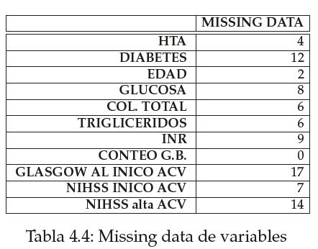
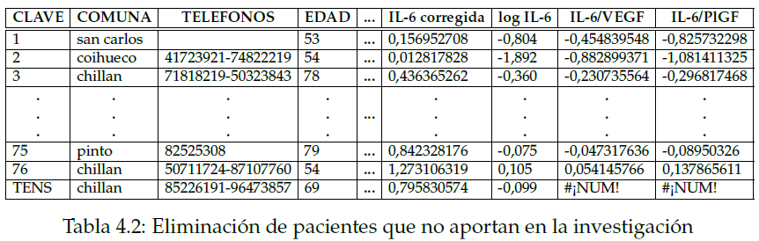
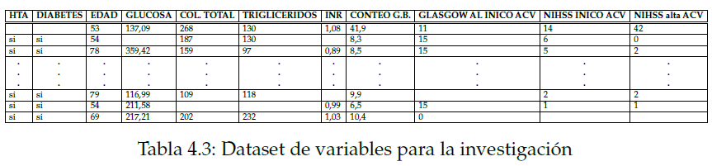
Colección de los datos de entrada

Slide 14
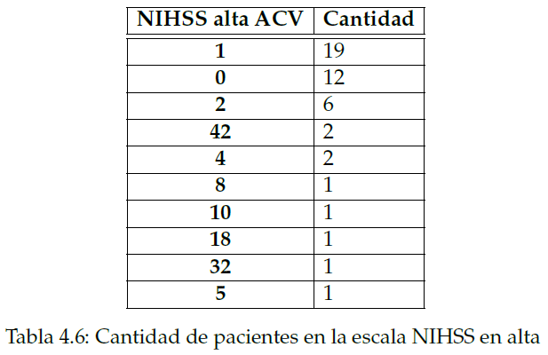
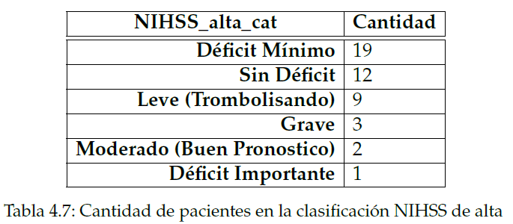
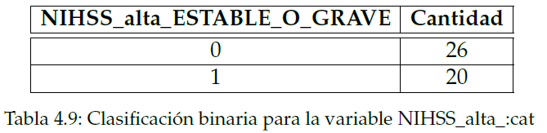
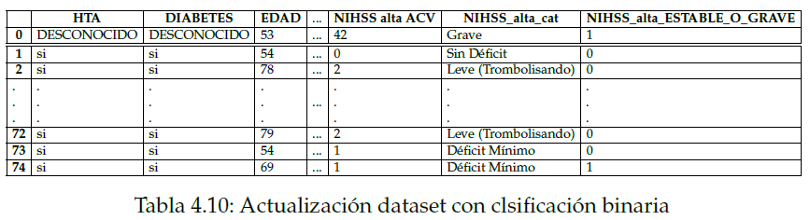
Procesamiento de los datos de entrada

Slide 15
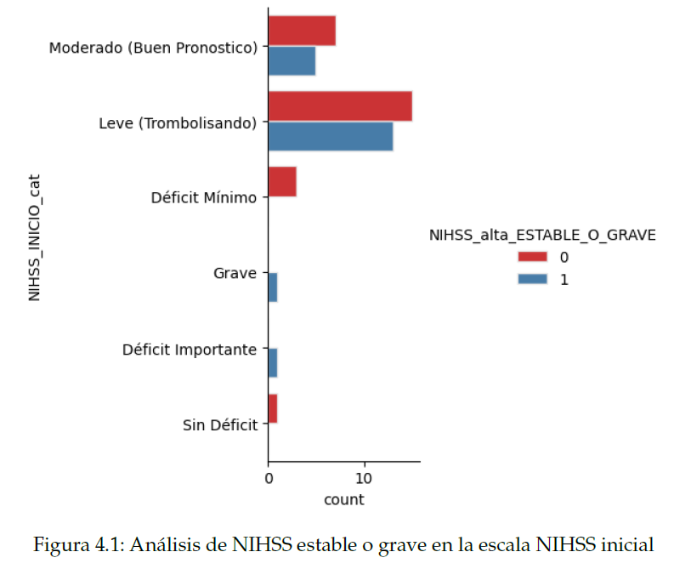
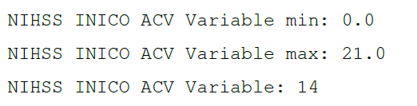
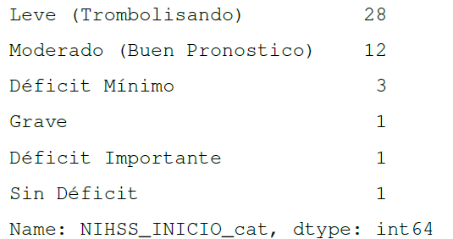
Procesamiento de los datos de entrada

Slide 16
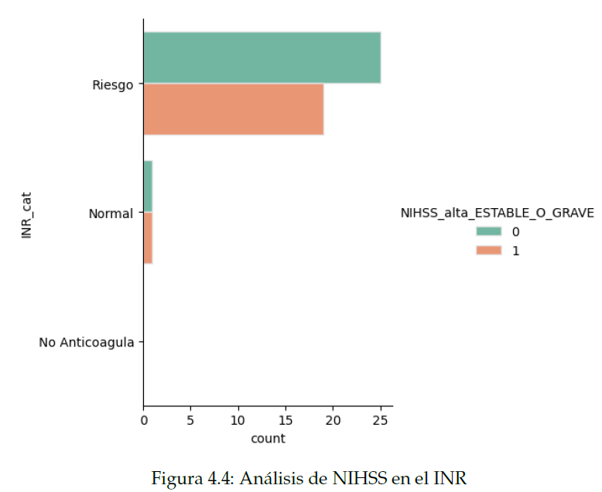
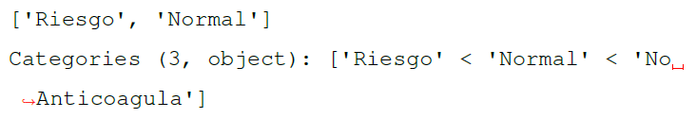
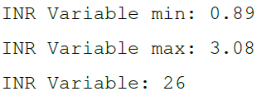
Procesamiento de los datos de entrada

Slide 17
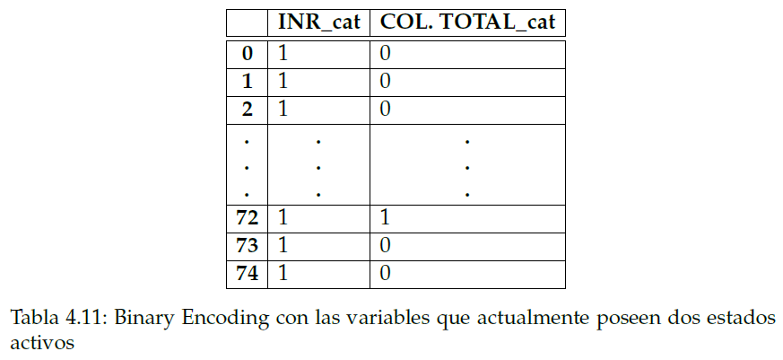
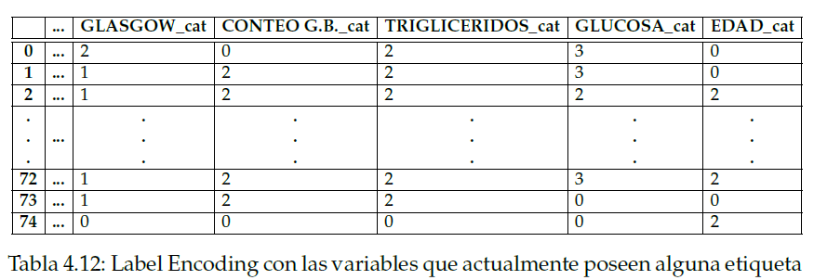
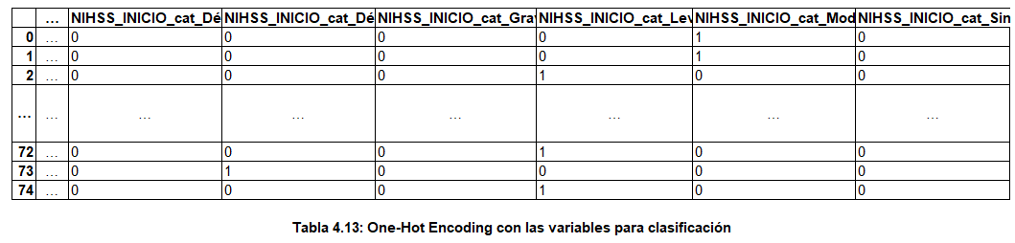
Procesamiento de los datos de entrada

Slide 18
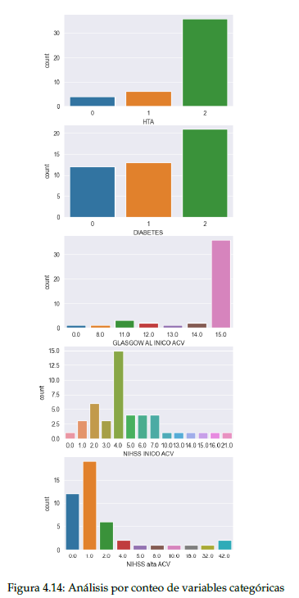
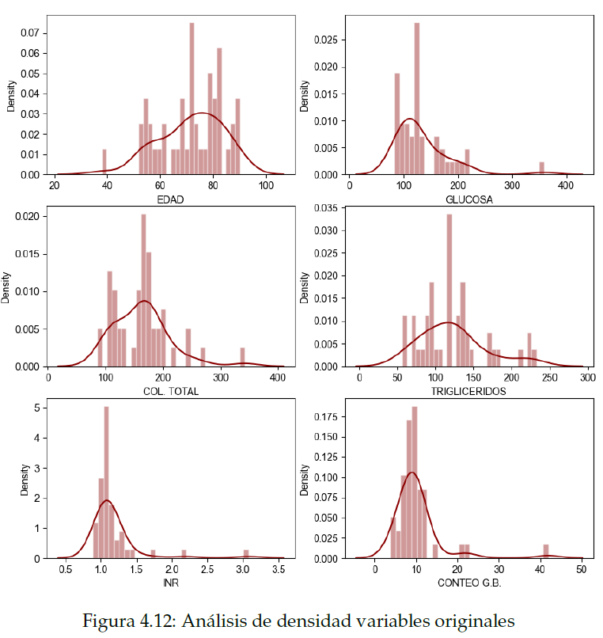
Análisis de los datos de entrada

Slide 19
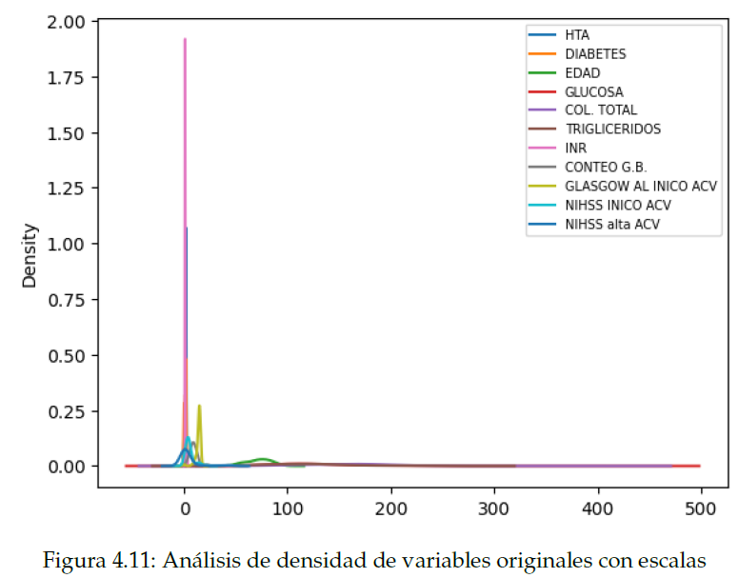
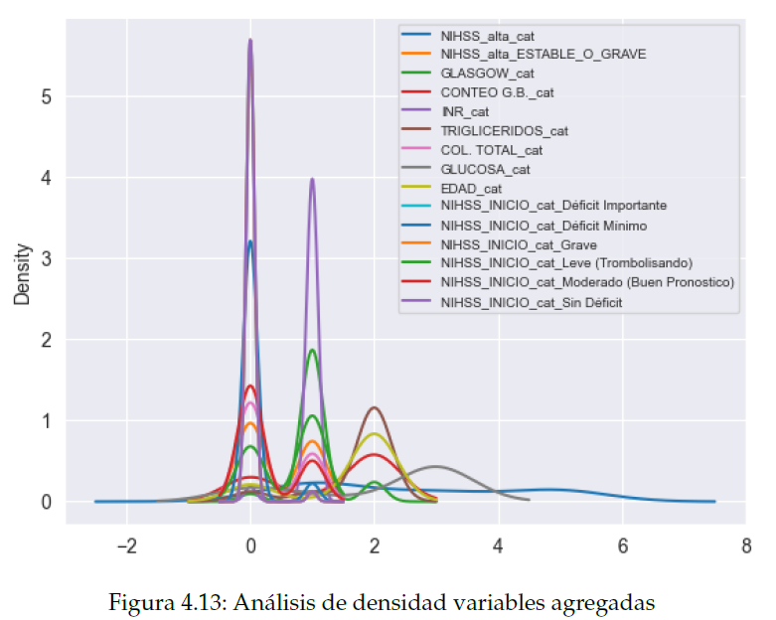
Análisis de los datos de entrada

Slide 20
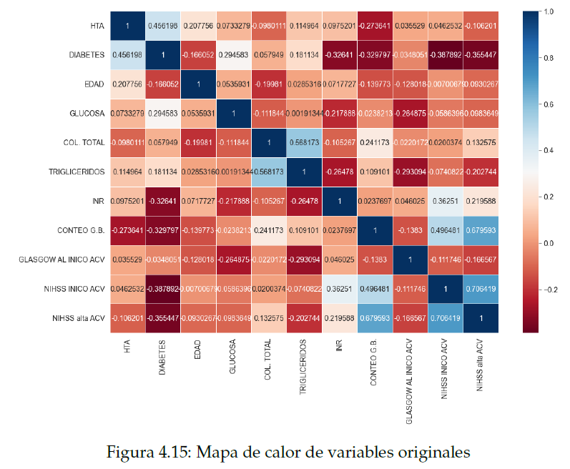
Análisis de los datos de entrada

Slide 21
Entrenamiento
 | Estado | Precisión | Recall | F1-score | Precisión Final
Naïve Bayes | 0 | 80 | 100 | 89 | 85,29
 | 1 | 100 | 64 | 78
Logistic Regression | 0 | 100 | 100 | 100 | 100
 | 1 | 100 | 100 | 100
Decision Tree | 0 | 100 | 100 | 100 | 100
 | 1 | 100 | 100 | 100
Random Forest | 0 | 100 | 100 | 100 | 100
 | 1 | 100 | 100 | 100
Porcentaje de resultados de métricas

Slide 22
Technology Infographics
Focal Length / Aperture
 | F/2.8 | F/4 | F/5.6 | F/8 | F/11 | F/16 | F/22
16mm | 10 | 7 | 5 | 3.6 | 2.5 | 1.8 | 1.3
20mm | 15.5 | 11 | 7.8 | 5.5 | 3.9 | 2.8 | 2
24mm | 22.3 | 15.8 | 11.2 | 8 | 5.7 | 4 | 2.9
28mm | 30.4 | 21.5 | 15.2 | 10.8 | 7.7 | 5.5 | 3.9
35mm | 47.5 | 33.6 | 23.8 | 17 | 12 | 8.5 | 6
50mm | 96.8 | 68.5 | 48.5 | 34 | 23 | 17.1 | 11.9
Distance in Feet

Slide 23
Literatura relacionada
NIHSS
Desafíos Bioéticos en la IA
Escala médica de Neurolgia.
It’s a gas giant and has several rings
Logistic Regression
Decision Tree
Algoritmo de Machine Learning.
It’s the farthest planet from the Sun
Naïve Bayes
Random Forest
Earth is the third planet from the Sun
It’s the closest planet from the Sun

Slide 24
Technology Infographics
Jupiter
Jupiter is the biggest planet in the Solar System
Mars
Despite being red, Mars is actually a cold place
Neptune
Neptune is the farthest planet from the Sun

Slide 25
Technology Infographics
Saturn
It’s a gas giant and has several rings
Jupiter
Jupiter is the biggest planet of them
Neptune
It’s the farthest planet from the Sun
Mars
Despite being red, Mars is cold
Mercury
It’s the closest planet from the Sun
Earth
Earth is the third planet from the Sun

Slide 26
Technology Infographics
Mars
Jupiter
Despite being red, Mars is actually cold
25%
35%
Jupiter is the biggest planet of them all
Earth
Neptune
Earth is the third planet from the Sun
10%
40%
Neptune is the farthest planet from the Sun

Slide 27
Technology Infographics
Jupiter
Saturn
Jupiter is the biggest planet of them all
03
04
It’s a gas giant and has several rings
Mars
02
05
Neptune
Despite being red, Mars is actually cold
It’s the farthest planet from the Sun
Earth
01
06
Mercury
Earth is the third planet from the Sun
It’s the closest planet from the Sun

Slide 28
Technology Infographics
Jupiter
Mars
Saturn
Neptune
Jupiter is the biggest planet of them all
Despite being red, Mars is actually a cold place
Saturn is a gas giant and has several rings
Neptune is the farthest planet from the Sun

Slide 29
1
Jupiter
Jupiter is the biggest planet of them all
4
Neptune
Technology Infographics
Neptune is the farthest planet from the Sun
2
Mars
Despite being red, Mars is actually cold
5
Earth
Earth is the third planet from the Sun
3
Saturn
Saturn is a gas giant and has several rings

Slide 30
Technology Infographics
1
6
Jupiter
Saturn
Jupiter is the biggest planet of them all
It’s a gas giant and has several rings
2
5
Mars
Neptune
Despite being red, Mars is actually cold
It’s the farthest planet from the Sun
3
4
Earth
Mercury
Earth is the third planet from the Sun
It’s the closest planet to the Sun

Slide 31
Technology Infographics
Jupiter
Mercury
Jupiter is the biggest planet of them all
It’s the closest planet of the Sun
Neptune
Earth
It’s the farthest planet from the Sun
It’s the third planet from the Sun
Saturn
Mars
It’s a gas giant and has several rings
It’s actually a cold place

Slide 32
Technology Infographics
Saturn
Earth
It’s a gas giant and has several rings
It’s the third planet from the Sun
Jupiter
Neptune
Mercury
Jupiter is the biggest planet of them all
It’s the farthest planet from the Sun
It’s the closest planet of the Sun

Slide 33
Technology Infographics
Jupiter
Saturn
Jupiter is the biggest planet of them all
It’s a gas giant and has several rings
Mars
Neptune
Despite being red, Mars is actually cold
It’s the farthest planet from the Sun

Slide 34
Technology Infographics
Jupiter is the biggest planet of all the solar system
Despite being red, Mars is actually a really cold place
Jupiter
Mars
Saturn
Saturn is a gas giant and has several ring around it
Venus
Earth
Venus is the second planet from the Sun and has a beautiful name
It’s the third planet from the Sun and the only known to harbor life

Slide 35
Technology Infographics
Jupiter
Mercury
Jupiter is the biggest planet of them all
It’s the closest planet of the Sun
Neptune
Earth
It’s the farthest planet from the Sun
It’s the third planet from the Sun
Saturn
Mars
It’s a gas giant and has several rings
It’s actually a cold place

Slide 36
Technology Infographics
Jupiter
Earth
Jupiter is the biggest planet
Earth is where we live on
Mars
Neptune
Despite being red, it’s cold
It’s far away from Earth
Saturn
Venus
It has several rings
It has a beautiful name

Slide 37
Technology Infographics
Neptune
Earth
It’s the farthest planet from the Sun
It’s the third planet from the Sun
Jupiter
Mercury
Jupiter is the biggest planet of them all
It’s the closest planet of the Sun

Slide 38
Technology Infographics
Mercury
It’s the closest planet of the Sun
Earth
It’s the third planet from the Sun
Mars
Despite being red, Mars is a cold place

Slide 39
Technology Infographics
Jupiter
Jupiter is the biggest planet of them all
Earth
2
4
It’s the third planet from the Sun
Neptune
It’s the farthest planet from the Sun
1
3
5
Mars
It’s actually a cold place
Saturn
It’s a gas giant and has several rings

Slide 40
Technology Infographics
Jupiter
Mercury
Jupiter is the biggest planet of them all
It’s the closest planet of the Sun
Neptune
Earth
It’s the farthest planet from the Sun
It’s the third planet from the Sun
Saturn
Mars
It’s a gas giant and has several rings
It’s actually a cold place

Slide 41
Technology Infographics
Jupiter
Mercury
Jupiter is the biggest planet of them all
It’s the closest planet of the Sun
Neptune
Earth
It’s the farthest planet from the Sun
It’s the third planet from the Sun
Saturn
Mars
It’s a gas giant and has several rings
It’s actually a cold place

Slide 42
Technology Infographics
Neptune
Venus
It’s the farthest planet from the Sun
It’s the closest planet of the Sun
Jupiter
Earth
Mars
Jupiter is the biggest planet of them all
It’s the third planet from the Sun
Despite being red, it’s actually a cold place

Slide 43
Technology Infographics
Neptune
It’s the farthest planet from the Sun
Jupiter
Earth
Jupiter is the biggest planet of them all
It’s the third planet from the Sun
Mars
Mercury
Despite being red, it’s actually a cold place
It’s the closest planet from the Sun

Slide 44
Technology Infographics
1
3
5
Jupiter is the biggest planet of them all
Saturn is a gas giant and has several rings
Mercury is the closest planet of the Sun
2
4
6
Neptune is the farthest planet from the Sun
Earth is the third planet from the Sun
Despite being red, it’s actually a cold place

Slide 45
Technology Infographics
1
Jupiter
Jupiter is the biggest planet of them all
2
Mars
Despite being red, it’s actually a cold place
3
Saturn
Saturn is a gas giant and has several rings
4
Mercury
Mercury is the closest planet to the Sun
5
Neptune
Neptune is the farthest from the Sun

Slide 46
Technology Infographics
Jupiter
Neptune
Saturn
Mars
Mercury
Earth
Jupiter is the biggest planet
Neptune is the farthest planet
Saturn has several rings
Mars is actually a cold place
It’s the closest planet of the Sun
Earth is the third planet to the Sun

Slide 47
Technology Infographics
Jupiter
Saturn
Jupiter is the biggest planet of them all
It’s a gas giant and has several rings
Neptune
Mercury
It’s the farthest planet from the Sun
It’s the closest planet of the Sun

Slide 48
Technology Infographics
Mercury
It’s the closest planet of the Sun
Jupiter
Neptune
Jupiter is the biggest planet of them all
It’s the farthest planet from the Sun
Saturn
Mars
It’s a gas giant and has several rings
It’s actually a cold place
Earth
It’s the third planet from the Sun

Slide 49
Technology Infographics
Jupiter
Mercury
Jupiter is the biggest planet of them all
It’s the closest planet of the Sun
Neptune
Earth
It’s the farthest planet from the Sun
It’s the third planet from the Sun
Saturn
Mars
It’s a gas giant and has several rings
Despite being red, it’s actually a cold place

Slide 50
Technology Infographics
Jupiter
Saturn
Jupiter is the biggest planet
Saturn has several rings
Mars
Earth
Mars is actually a cold place
Earth is the the third planet
Neptune
Mercury
Neptune is the farthest planet
Mercury is the smallest planet

Slide 51
Instructions for use
In order to use this template, you must credit Slidesgo and Freepik in your final presentation and include links to both websites.
You are allowed to:
- Modify this template.
- Use it for both personal and commercial projects.
You are not allowed to:
- Sublicense, sell or rent any of Slidesgo Content (or a modified version of Slidesgo Content).
- Distribute Slidesgo Content unless it has been expressly authorized by Slidesgo.
- Include Slidesgo Content in an online or offline database or file.
- Offer Slidesgo templates (or modified versions of Slidesgo templates) for download.
- Acquire the copyright of Slidesgo Content.
For more information about editing slides, please read our FAQs or visit Slidesgo School:
https://slidesgo.com/faqs and https://slidesgo.com/slidesgo-school

Slide 52
Infographics
You can add and edit some infographics to your presentation to present your data in a visual way.
Choose your favourite infographic and insert it in your presentation using Ctrl C + Ctrl V or Cmd C + Cmd V in Mac.
Select one of the parts and ungroup it by right-clicking and choosing “Ungroup”.
Change the color by clicking on the paint bucket.
Then resize the element by clicking and dragging one of the square-shaped points of its bounding box (the cursor should look like a double-headed arrow). Remember to hold Shift while dragging to keep the proportions.
Group the elements again by selecting them, right-clicking and choosing “Group”.
Repeat the steps above with the other parts and when you’re done editing, copy the end result and paste it into your presentation.
Remember to choose the “Keep source formatting” option so that it keeps the design. For more info, please visit Slidesgo School.

Slide 53
Naïve Bayes
Es uno de los algoritmos más simples y poderosos para la clasificación basado en el Teorema de Bayes con una suposición de independencia entre los predictores. Naïve Bayes es fácil de construir y particularmente útil para conjuntos de datos muy grandes.
Donde:
P(h): es la probabilidad de que la hipótesis h sea cierta (independientemente de los datos). Esto se conoce como la probabilidad previa de h.
P(D): probabilidad de los datos (independientemente de la hipótesis). Esto se conoce como probabilidad previa.
P(h|D): es la probabilidad de la hipótesis h dada los datos D. Esto se conoce como la probabilidad posterior.
P(D|h): es la probabilidad de los datos d dado que la hipótesis h era cierta. Esto se conoce como probabilidad posterior.

